Slide 1




PRE
TECH NOVA
SCIENCE AND TECHNICAL COMMITTEE

Slide 2
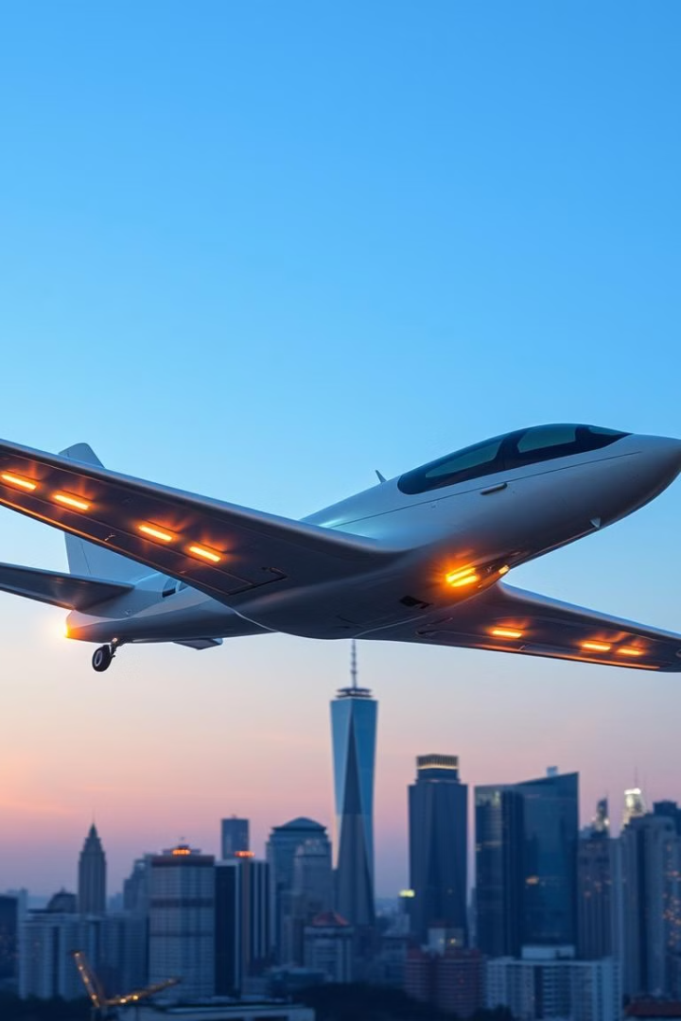
SkySpark – Igniting the future of electric skies.
Domain
Sustainable aviation in transportion systems
Team CRETUS
Aryan Parikh - 24BCP042
Anusmita Sen - 23BEE080
Laksh Baldaniya - 24BCP030
Priaan Pancholi - 23BME131
Faculty Mentor
Dr. VIPIN SHUKLA

Slide 3
Introduction to Sustainable Aviation
The Challenge
Our Goal
The aviation industry is a significant contributor to global greenhouse gas emissions, noise pollution, and air traffic congestion. Current methods of air travel rely heavily on fossil fuels, resulting in a substantial carbon footprint and contributing to climate change. Furthermore, noise pollution from aircraft impacts communities near airports, and increasing air traffic necessitates more efficient air traffic management systems. Addressing these challenges is vital for the long-term sustainability of air travel.
This hackathon aims to inspire innovative solutions that address the environmental and operational challenges facing the aviation industry. We encourage exploration of alternative fuels, advanced propulsion systems, improved aircraft design, and more efficient air traffic management techniques. The goal is to develop solutions that reduce the environmental impact of aviation while maintaining or enhancing operational efficiency and safety. We seek ideas that are both technologically feasible and economically viable.

Slide 4



Challenges in the Aviation Industry
Greenhouse Gas Emissions
Noise Pollution
Aircraft noise can disrupt communities near airports and impact wildlife.
Aviation is responsible for a significant amount of greenhouse gas emissions, contributing to climate change.
Fuel Consumption
The aviation industry relies heavily on fossil fuels, which are a finite resource and contribute to environmental pollution.

Slide 5
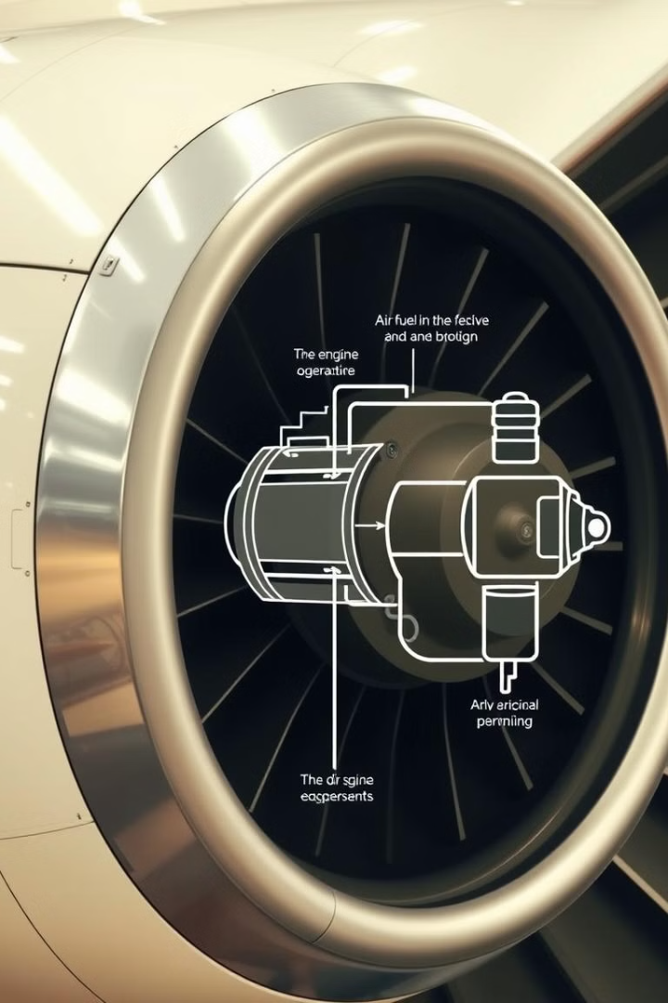



Drawbacks in Jet Engines
Fuel Efficiency
Traditional jet engines have limited fuel efficiency, leading to high fuel consumption and emissions.
Noise Pollution
Jet engine noise is a major source of noise pollution, impacting nearby communities.
Emissions
Jet engines emit greenhouse gases and other pollutants, contributing to air pollution.

Slide 6
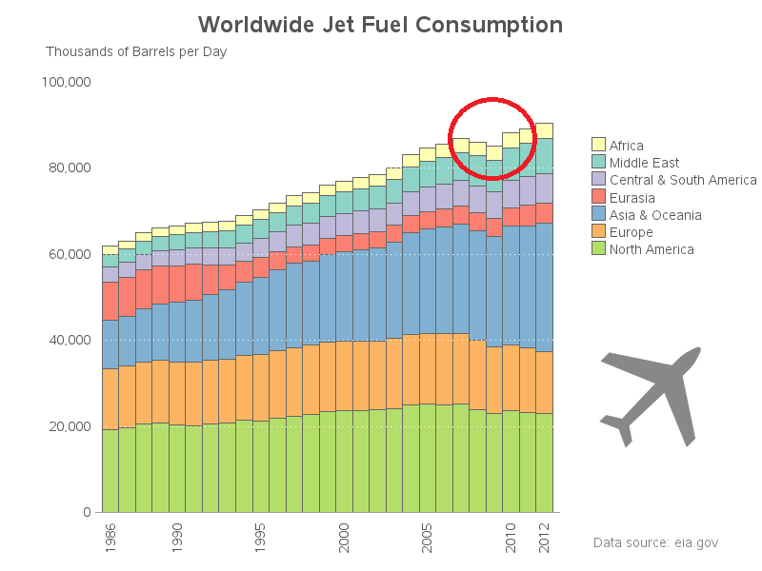
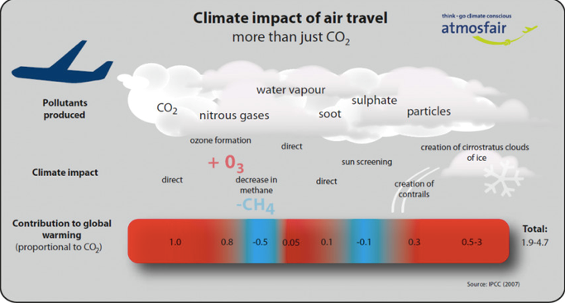
Data About Jet Engines
80%
Fuel Consumption
Fuel accounts for over 80% of the operating costs of a commercial airline.
2%
Emissions
The aviation industry is responsible for about 2% of global carbon dioxide emissions.
75%
Noise
Over 75% of noise complaints related to airports are due to aircraft operations.

Slide 7
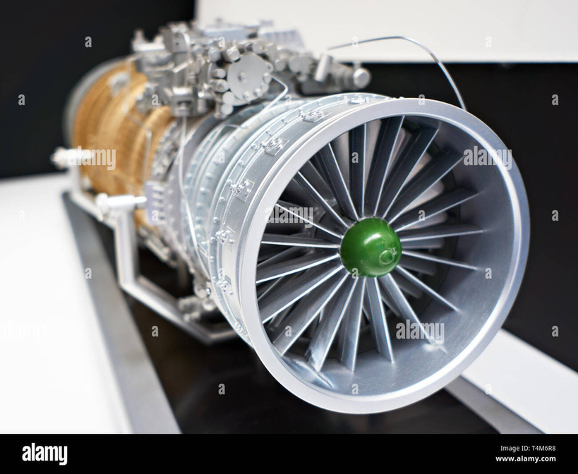
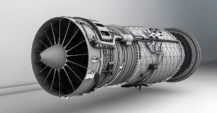
Jet Engine vs Electric Motor
Jet Engine
Electric Motor
Traditional jet engines rely on combustion, burning fuel to generate thrust.
Electric motors use electricity to generate thrust, offering a cleaner alternative.
Jet engines are complex and require regular maintenance.
Electric motors are more efficient and require less maintenance than jet engines.

Slide 8
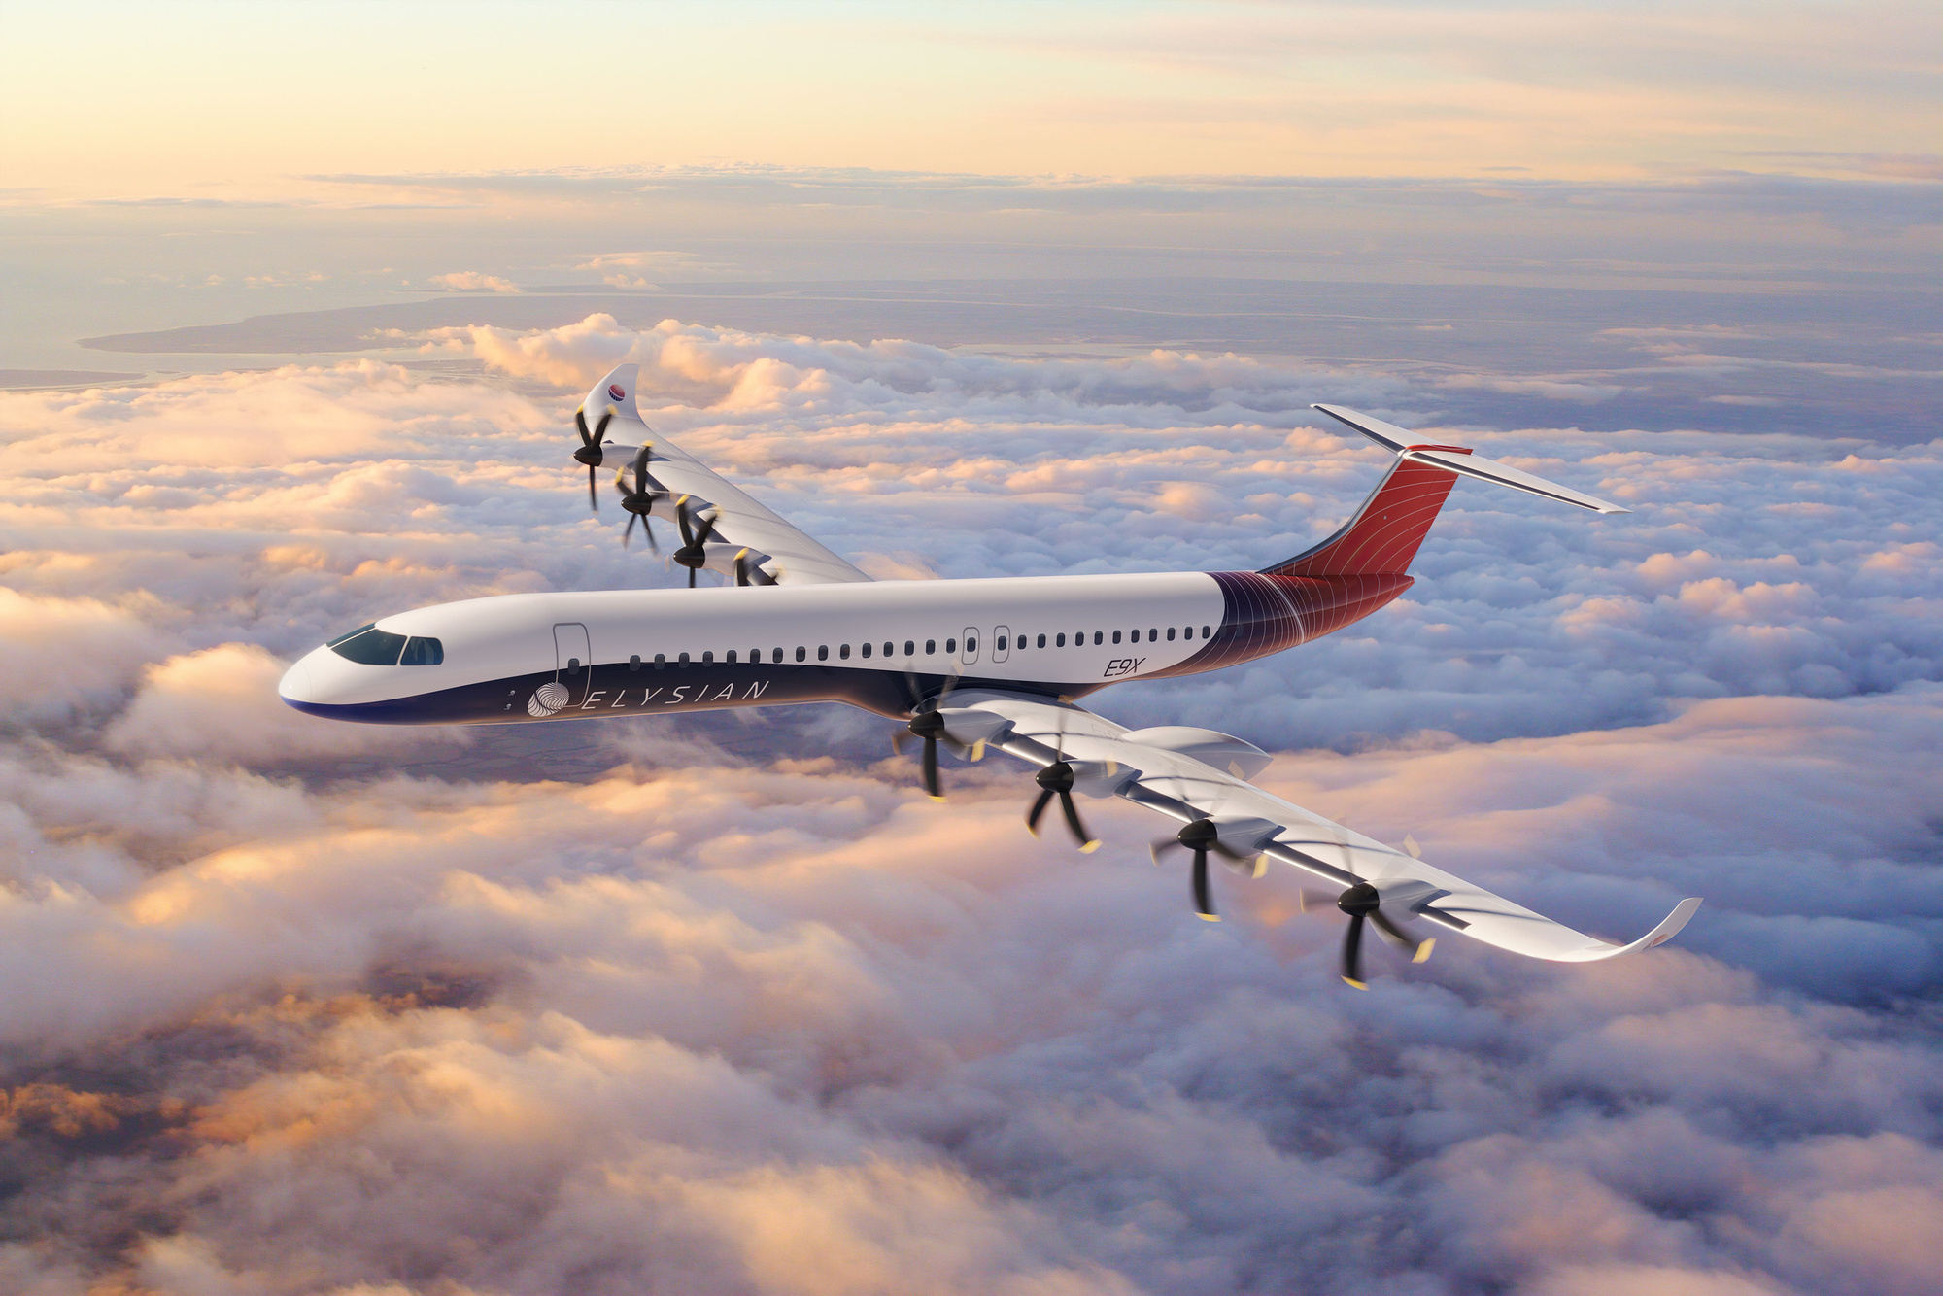

Electric Aviation: Advantages
Quick Response
Less Noise
1
Electric motors provide immediate speed control.
2
Electric planes are significantly quieter.
Differential Thrust
Less turbulence
3
Motors automatically draw more power.
4
Better Handling of windy situations.

Slide 9
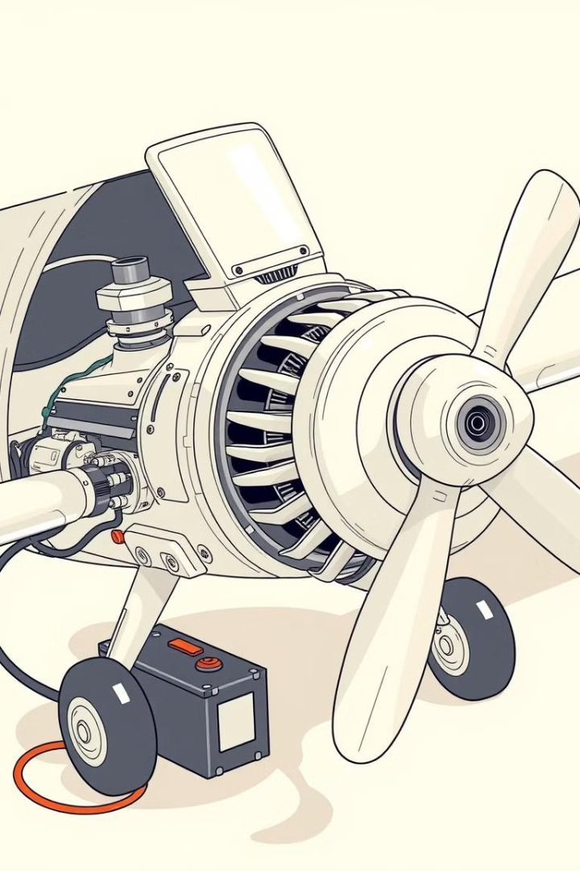
Speed
Problem: In propeller airplanes, increasing blade pitch boosts thrust but also raises blade load, reducing propeller speed due to reaction torque. To maintain constant speed, turbojet engines need a separate governing mechanism
We started brainstorming solutions to the challenges in propeller airplanes. We explored different concepts and technologies to find a viable solution.

Slide 10
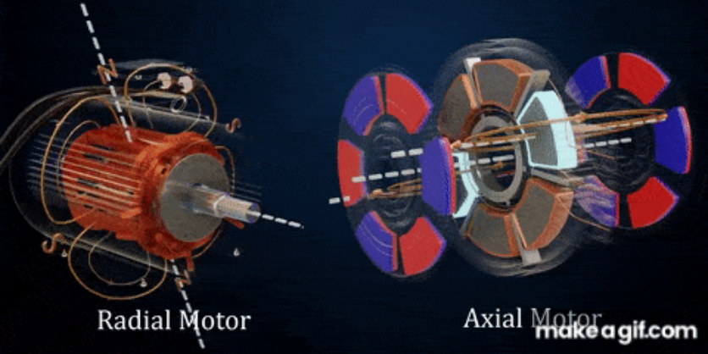
Axial Flux Motor
Axial flux motors differ from traditional radial flux motors in how the magnetic flux flows.
In a radial flux motor, the magnetic flux flows radially (from the center outward).
In an axial flux motor, the magnetic flux flows along the axis of rotation, parallel to the motor's shaft.
This design makes axial flux motors flatter and more compact, often described as "pancake-shaped.
It will automatically draw more power from the source to maintain a constant speed. When you compare this to a normal motor, you can see that a lot of flux lines are escaping without interacting with the rotor. However, in axial flux motors, most of the flux lines generated by the stator are linked to the rotor delivering greater efficiency.
Remember turbo prop airplanes need a transmission between the engine and propeller. This became possible because in axial flux motors it is quite easy to increase the diameter of the rotor without increasing its weight
Our team has calculated the following findings how this axial flux motor is better.

Slide 11
Axial Flux Motor Efficiency
Let’s calculate and compare efficiency,input energy and torque for a specific propulsion system using a 1 MW (1000 kW) example for both a jet engine and an axial flux motor.
Jet Engine Example:
Model: CFM56-7B (used in Boeing 737 aircraft).
Power Output: 105 kN thrust (~21 MW).
Weight: 2360 kg.
Efficiency: 38% (thermal).
From the thrust and fuel burn, torque output can be estimated for equivalent mechanical power.
Axial Flux Motor Example:
Model: YASA P400R (widely used for electric aviation prototypes).
Power Output: 200 kW.
Weight: 26 kg.
Efficiency: 96%

Slide 12
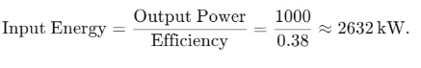
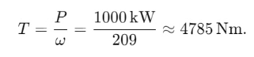
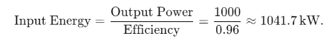
Efficiency Comparison Torque Comparision
Jet Engine:
Jet Engine:
Efficiency: 38%.
Approximation: Propeller speed ~2000 RPM (209 rad/s).
Input energy for 1 MW output:
Torque output:
Axial Flux Motor:
Axial Flux Motor:
Efficiency: 96%.
Torque density: 80 Nm/kg (YASA P400R).
Input energy for 1 MW output:
Weight for 1 MW: 130 kg.
Torque output: = Torque Density × Weight = 80 × 130 = 10,400 Nm .
T=Torque Density×Weight=80×130=10,400Nm.
Energy Savings=2632−1041.7≈1590 kW ( 60% less energy input required).

Slide 13
\ ]’ PARAMETEReteer | JET ENGINE | AXIAL FLUX MOTOR | ADVANTAGE
EFFICIENCY | ~35 | ~96 | 63.5% more efficient
Energy Input (kW) | ~2632 | ~1041.7 | ~1590 kW less input energy needed
Torque Output (Nm) | ~4785 | ~10,400 | 2.2x higher torque

Slide 14
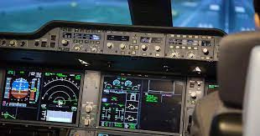
Autopilot
An innovative idea for autopilot systems in sustainable aviation could focus on Autopilot with AI-Driven Optimal Flight Path.
AI systems use real-time data (altitude, air pressure, engine performance, weight distribution, and weather) to determine the optimal climb trajectory for minimal fuel burn.
Integrates real-time weather, wind speeds, and air traffic data to adjust the flight path, thus finding the shortest path.
Communication with advanced air traffic systems allows multiple aircraft to "cruise in formation," similar to how birds fly in V-formations to reduce drag and save fuel.
Benefits:
Reduces fuel consumption by dynamically optimizing climb, cruise,
and descent phases.
Reduces carbon emissions, contributing to sustainable aviation.
Incorporates renewable energy (solar power) into long-haul flights.
Machine learning ensures continuous improvement in fuel efficiency.

Slide 15
Architecture Model
Data
Module | Purpose
Takeoff | Analyzes climb trajectory to minimize fuel burn.
Route Optimizer | Processes weather, air traffic, and GPS data to calculate shortest path.
Fuel & Thrust | Adjusts engine thrust and fuel delivery for optimal aerodynamic performance.
Machine Learning Engine | Continuously learns from previous flights to recommend optimal speed, routes, and thrust patterns.

Slide 16
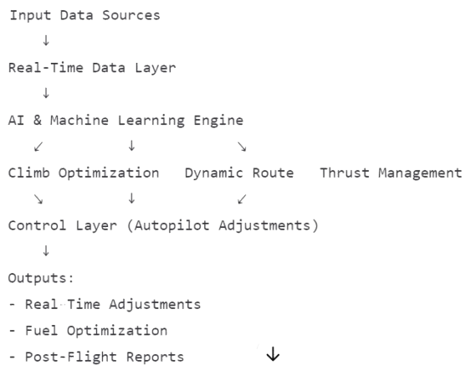
Visual Flowchart

Slide 17





Approach to Solve the Problem
Ideation & Brainstorming
1
The first step in solving any problem is to understand its root cause, potential solutions, and how to effectively address them. This is the ideation and brainstorming phase.
2
Design the Solution
Based on the brainstorming session, a design process will occur to determine the most optimal solution.
Technology Stack Selection
3
The next step is to determine the best technological tools to implement the solution and meet the requirements for the product.
Development Phase
4
The development phase involves building the solution, which includes coding, testing, and refinement.
Scaling the Solution
5
The last step is to scale the solution to accommodate the intended users and their requirements.

Slide 18

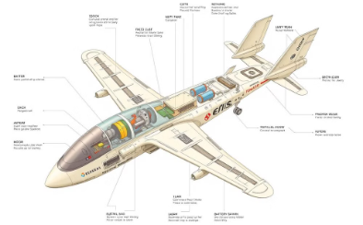
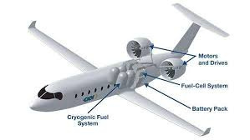
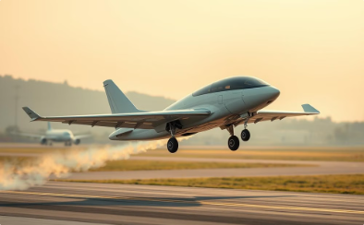
Ideation and Brainstorming
Collaborative Environment
Electric Aircraft Design
Battery Technology Innovation
Sustainable Future of Aviation
Our brainstorming sessions bring together experts from various fields to explore innovative electric aircraft solutions.
We are focusing on feasible electric aircraft designs that are both environmentally friendly and cost-effective.
Our vision is to create a future where electric aircraft play a crucial role in achieving sustainable air travel.
We are committed to researching and developing cutting-edge battery technologies to power electric aircraft efficiently.

Slide 19
Designing the Solution
Engineering Expertise
Safety and Regulation
Collaborate with experienced aerospace engineers, leveraging their knowledge to craft innovative and efficient electric aircraft.
Conduct rigorous testing to ensure the aircraft meets industry-standard safety requirements and complies with regulatory guidelines.
1
2
3
Prototyping and Testing
Construct prototypes to validate theoretical designs, enabling iterative improvements and adjustments.

Slide 20
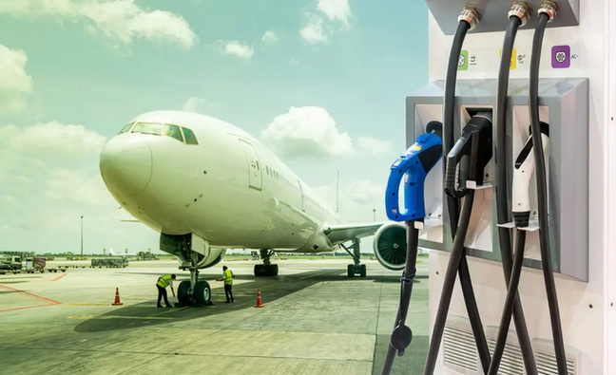
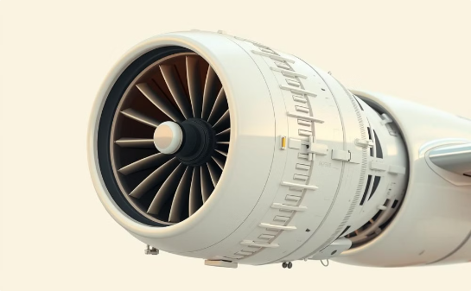

Technology Stack Selection
Advanced Battery Technologies
Efficient Electric Motors
Smart Flight Management Systems
Axial flux motors provide high thrust-to-weight ratios, enhancing aircraft performance with optimized energy utilization. This technology enables efficient flight with minimal energy consumption.
Solid-state batteries offer enhanced energy density, while lithium-sulfur batteries promise extended range and faster charging. These innovations enable longer flights and reduced environmental impact.
Advanced software and control systems enhance energy efficiency, optimize flight paths, and provide real-time insights for informed decision-making. These systems contribute to sustainable and cost-effective air travel.

Slide 21
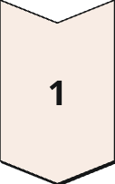
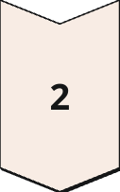
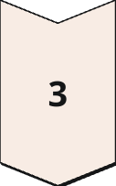
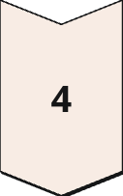
Development Phase
Prototype Construction
Build multiple prototypes for testing battery performance, motor efficiency, and safety.
Testing and Evaluation
Test battery longevity, charging times, and range through simulations and real-world flights.
Safety Certification
Work with regulators to ensure the electric aircraft meets safety certifications and complies with regulations.
Iterative Improvements
Make iterative improvements based on test results to enhance performance and address any challenges.

Slide 22

Scaling the Solution
Infrastructure Deployment
Construct a network of charging stations at airports to support electric aircraft. This ensures seamless charging for aircraft, providing a convenient and efficient experience for passengers.
1
Manufacturing Scale-Up
2
Increase production capacity to meet growing demand for electric aircraft. This involves optimizing manufacturing processes and investing in automation to reduce costs and increase efficiency.
Market Expansion
Begin with regional electric aircraft, serving shorter routes to gain initial market traction. As technology improves, gradually expand to longer routes, ensuring wider adoption.
3
Partnerships
4
Collaborate with airlines, energy providers, and governments to create a comprehensive electric aviation ecosystem. This integration ensures smooth transition and widespread acceptance of electric aircraft.
Continuous Innovation
Invest in research and development to continuously improve battery technology, range, and energy-efficient flight paths, driving progress and sustainability in the electric aviation industry.
5

Slide 23

Impact and Benefits
User Benefits
Community Benefits
Lower ticket prices
Improved air quality
Reduced travel costs
Reduced noise pollution
Eco-friendly choice
Enhanced public health
Social Impact
Economic Impact
Increased accessibility
Job creation in the electric aviation sector
Promotion of sustainability
Reduced fuel costs for airlines
Reduced carbon footprint
Economic growth and investment

Slide 24
Resources and References
Books and Reports
Research Papers
Industry News
The book "Electric Flight: The Breakthrough of Zero-Emission Aviation" by David J. B. L. Gantt explores the technical aspects of electric flight.
"Electric Aircraft: A Global Review" published in aviation journals provides a comprehensive overview of electric aircraft developments worldwide.
Vertical Aerospace and Joby Aviation are leading companies pushing the boundaries of electric aircraft innovation, driving progress in the industry.
NASA's Electric Aircraft Initiative, a research program dedicated to electric flight technology, offers valuable technical data and advancements.
The Electric Aircraft Symposium, a platform for industry professionals, brings together experts to discuss the latest developments and challenges in electric aviation.

Slide 25
Thank You

